Slide 1
Audio AMP rework SOP
2020/08/31

Slide 2
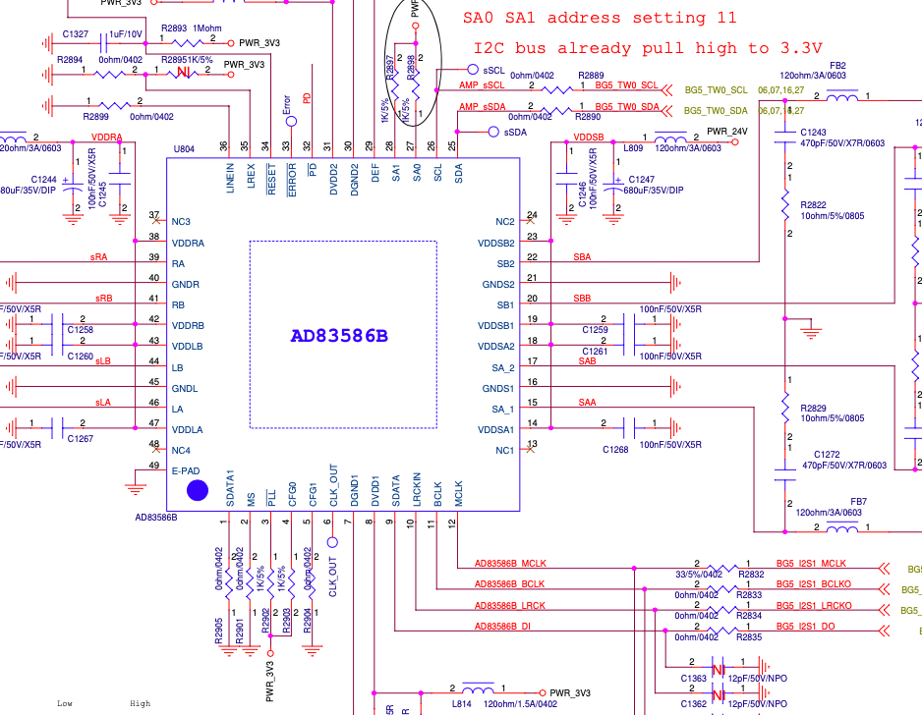
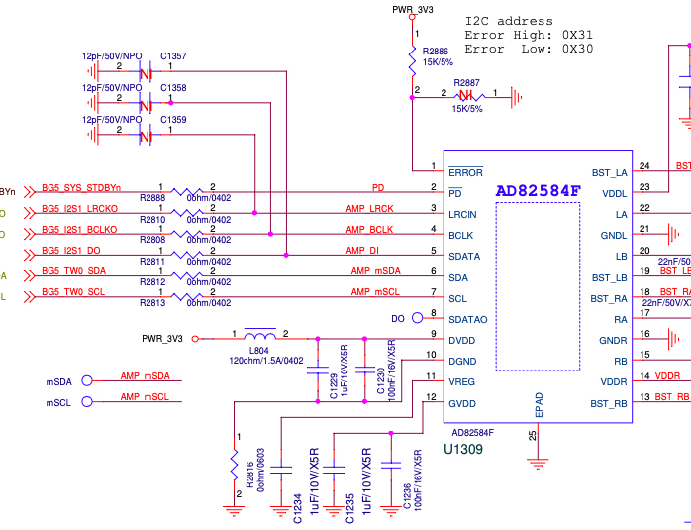
AD83586B & AD83584F-Schematic

Slide 3
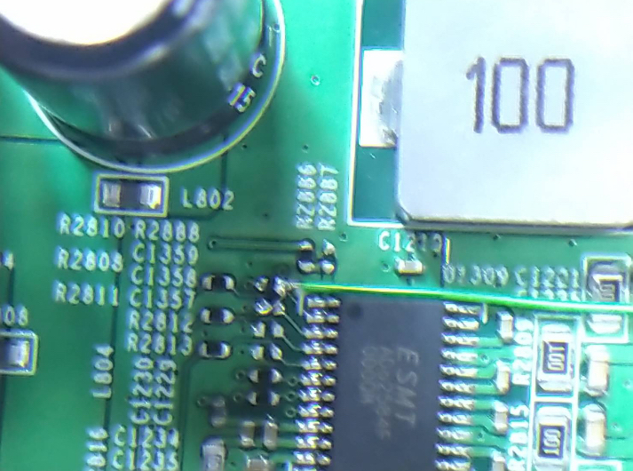
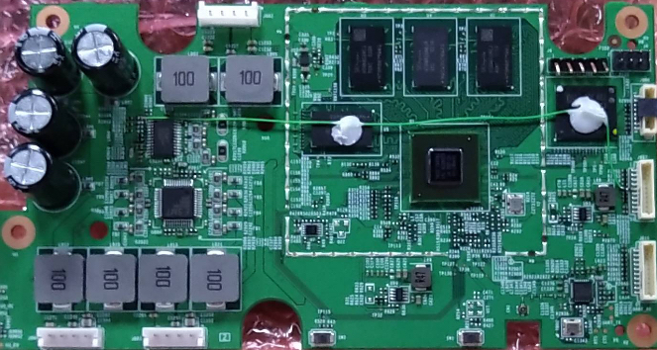
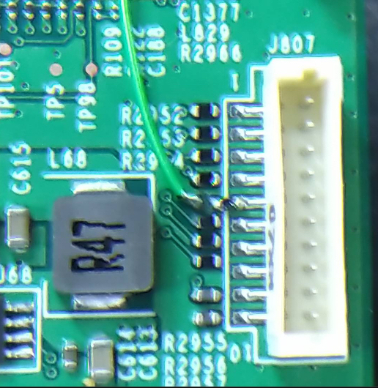
PD pin rework.
Question1.
What is Volume up connection?
PD: Remove R2888 original 0 ohm resistor. Change 10K ohm to GND.
GPIO 32: Use Volume up key to be used for PD pin.

Slide 4
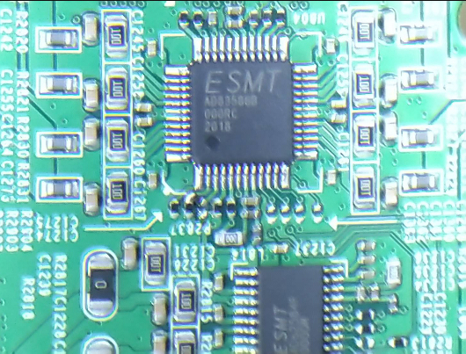
PLL pin rework.
Question2.
R2902 is open in your picture?
Which resistor change to 1K(pull-down)?
PLL: Change 1K to GND.

Slide 5
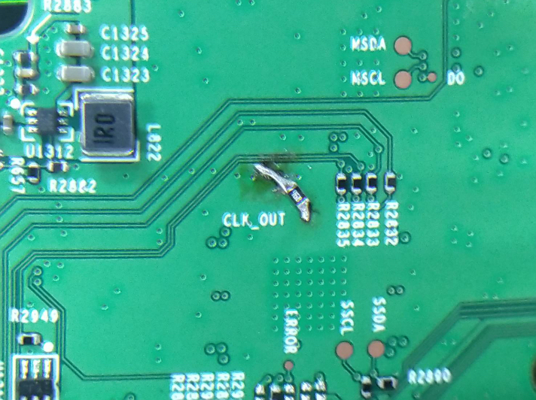
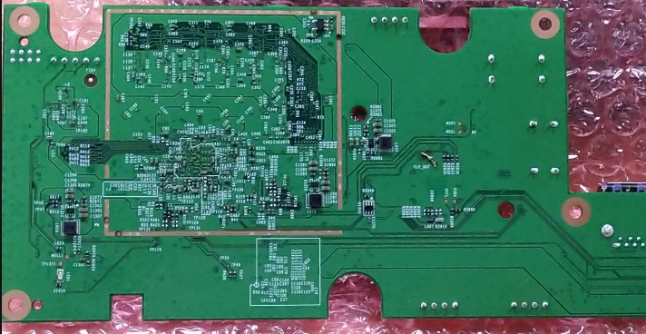
CLK_OUT pin rework.
CLK_OUT: Change 10K to PWR_3V3.

Slide 6
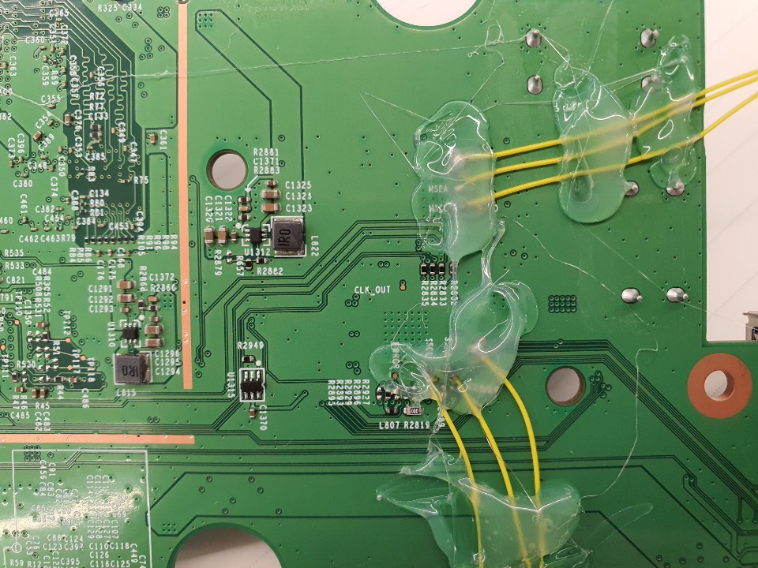
CLK_OUT pin rework.
3V3(?)
CLK_OUT: Change 10K to PWR_3V3.
Question3.
Which via is CLK_OUT? Which via is +3.3V?
CLK_OUT(?)

Slide 7
Rework point of AD83586B/AD83584F audio AMP
1. PIN 3: /PLL
  --> Need to connect a 1K pulled-low RES to GND. This is for using internal PLL instead of external clock source for MCLK. Since the current system MCLK is 24MHz, which can not meet the MCLK frequency requirement of AD83586B.
2. PIN 6: CLK_OUT
  --> Need to connect a 10K pulled-high RES to PWR_3V3, This is to set PLL ratio to one time instead of 4 times to avoid the system MCLK over flow and cause noise issue.
3. PIN 32: /PD
  --> Need to connect it to a normal GPIO instead of always-on SM_GPIO9 (we will rework /PD pin connect to GPIO32, which is used for volume up control in EVT board) , and connected a 10K pulled-low resistor to GND.
  This is used to set the /PD pin remain in low state and ensure that the audio AMP enter to power down mode during the system reboot due to unexpected event.

